Slide 1
MU Libraries All-Staff Meeting January 13, 2011
Welcome
Introduction of new employees (Jim Cogswell)
Mizzou Advantage update (Kate Anderson)
Assessment Committee report (Maryellen Sievert)
Upcoming Events (Shannon Cary)
Libraries Budget Analysis (Jim Cogswell)
Libraries Staffing analysis (Jim Cogswell)
Questions/Discussion

Slide 2
Mizzou Advantage Update
13 January 2011

Slide 3
Mizzou Advantage Initiatives
Food for the Future (Jo Britt-Rankin)
Media of the Future (Charles Davis)
One Health, One Medicine (Carolyn Henry)
Sustainable Energy (Cerry Klein)
Disruptive Technology (Carsten Strathausen)
AND, Education (LuAnne Roth)

Slide 4
Mizzou Advantage Grants
Print for the People
Mike Holland
Newspaper Archives
Dorothy Carner
Architecture of Collaboration
Kate Anderson

Slide 5
http://muconf.missouri.edu/futureofarchives
February 24 - 25

Slide 6
http://www.rjionline.org/events/stories/newpaper-archive/
April 10 - 12

Slide 7
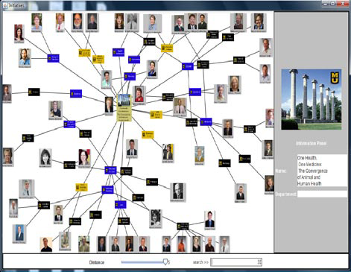
Architecture of Collaboration
Mizzou Advantage Poster Session
April 27th, 3 – 6 pm, Reynolds

Slide 8
Other Big Projects
Advisory Boards
Benchmarking & Assessment
Proposal Review
MOspace

Slide 9
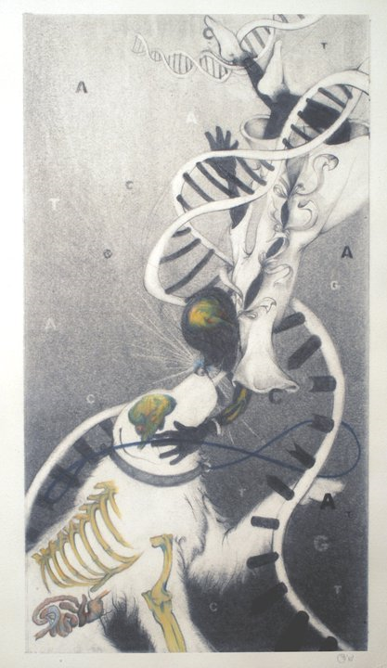
Good source of MA info:
Facebook!
Man’s Best Friend
By George Szabo
Winner: MA Juried Art Contest

Slide 11
Classified Positions

Slide 12
Academic Positions

Slide 13
Net Percentage Change since 2000
Students 23,280
Classified: 122
Academic: 47

Slide 14
FTE Lost (by Division) Open Positions Not Filled & Salary Line Eliminated
(6)
8.75
5.0

Slide 15
Retirement Eligibility - Classified

Slide 16
Retirement Eligibility - Academic

